Slide 1
Pressure induced opto-electronic, elasto-mechanical and thermoelectric properties of cubic FrBCl₃ (B = Ge, Sn): DFT investigation
Mohammad Abdur Rashid
Md. Borhanul Asfia, Sahadat Jaman

Slide 2
Outline
Lead-free perovskite
Our systems of study: FrGeCl₃ and FrSnCl₃
Computational details
Opto-electronic properties
Mechanical properties
Thermoelectric properties
Conclusions

Slide 3
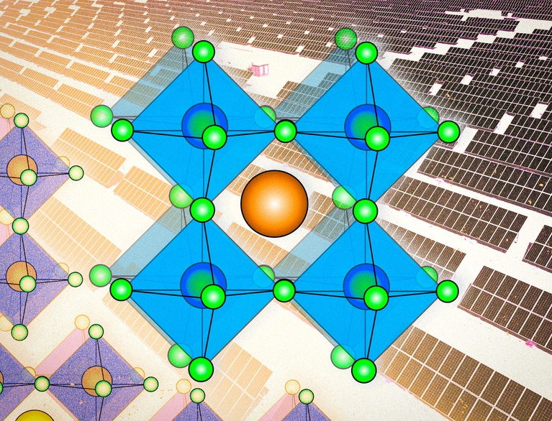
Perovskite solar cells
High power conversion efficiency (about 25%)
Easier manufacturing process
Lower cost and greater flexibility
Perovskites degrade much faster
Pb-based perovskites show better
potential but they are toxic
https://news.mit.edu/2022/perovskites-solar-cells-explained-0715

Slide 4
Environmental sources of lead exposure
https://www.cdc.gov/nceh/lead/publications/refugeetoolkit/powerpoint_files/medicalservice.ppt

Slide 5
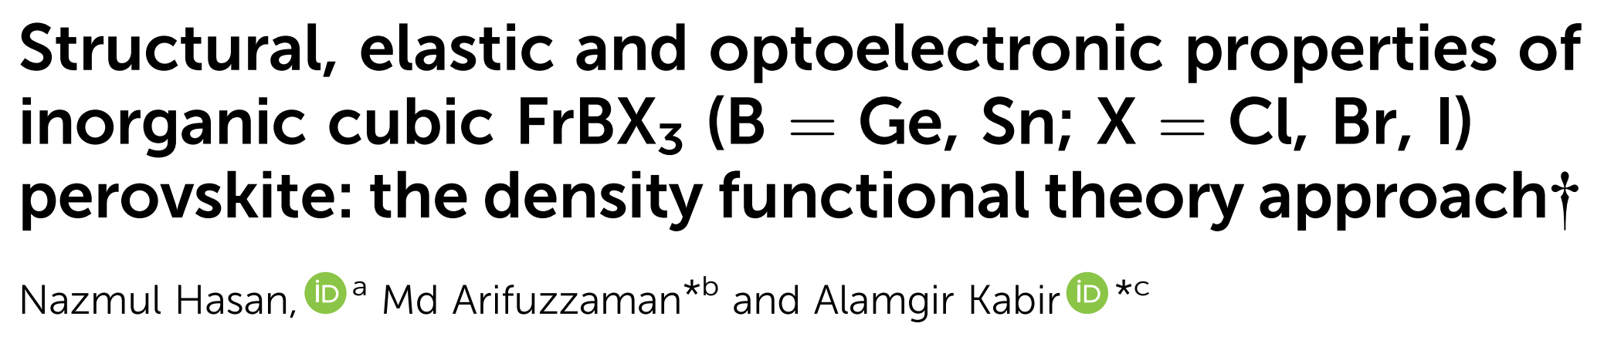
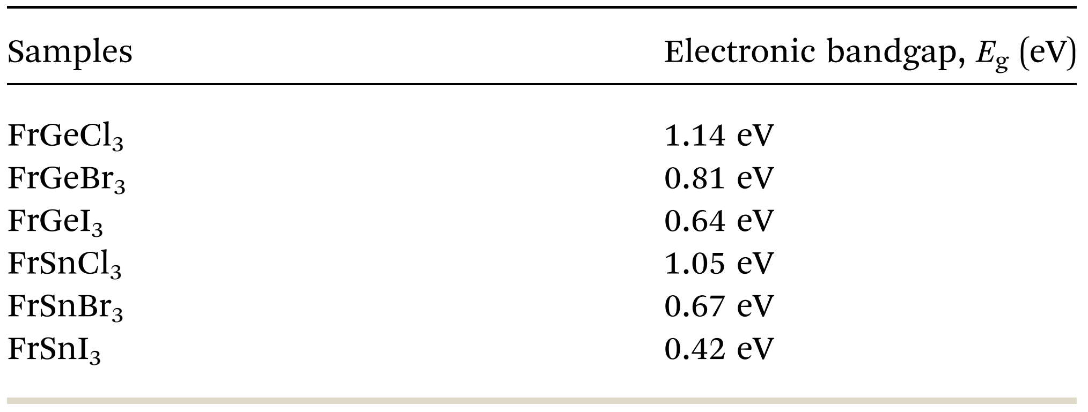
RSC Advances, 2022, 12, 7961

Slide 6
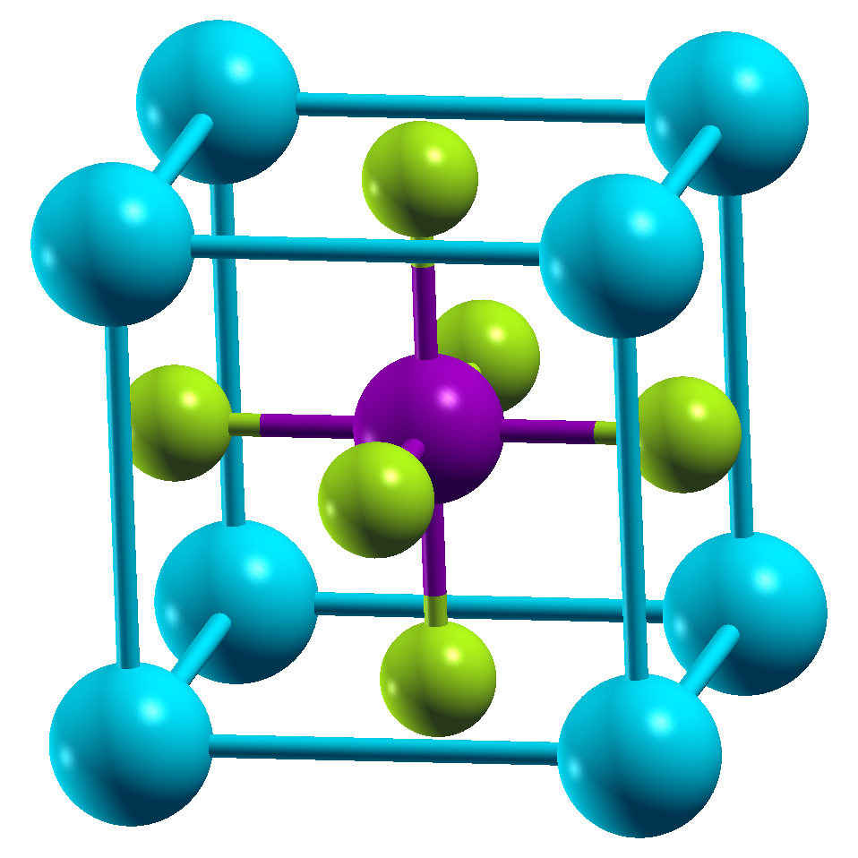
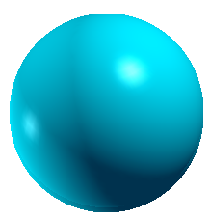
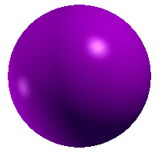
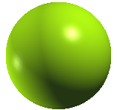
Structure of FrBCl₃ (B = Ge, Sn)
Rb
Ge/Sn
Cl

Slide 7
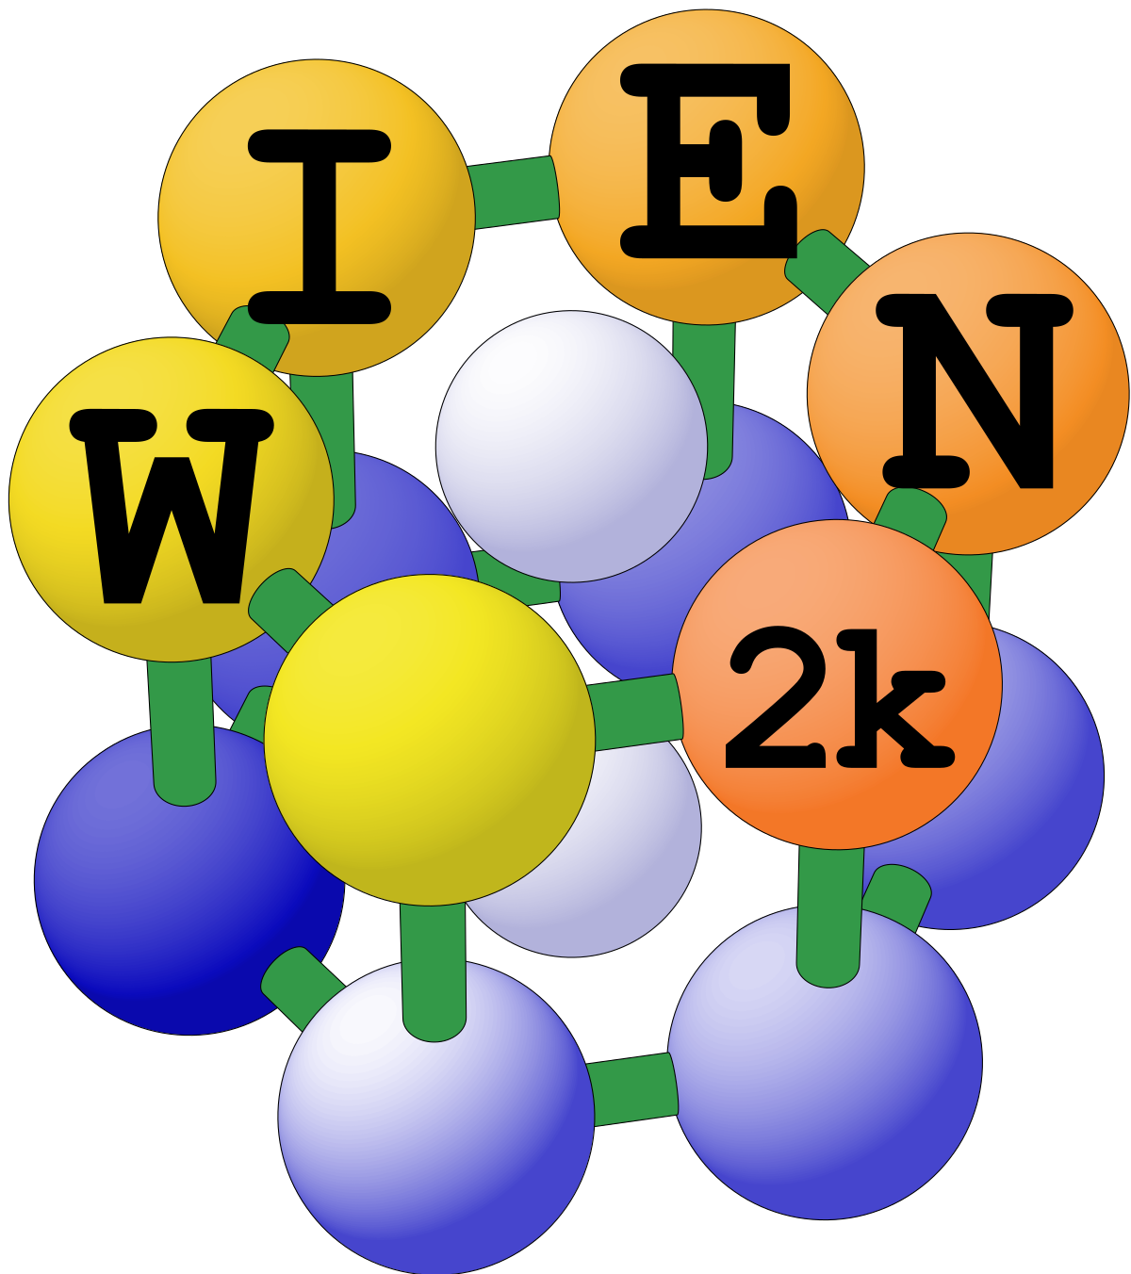
Computational details
R_{MT}(Fr, Sn, Ge) = 2.35 a.u.
R_{MT} (Cl) = 2.32 a.u.
R_{MT}×K_{max} = 8.0
K-mesh = 10×10×10
EC = 0.00001 Ry & CC = 0.0001 e

Slide 8
Optimized Lattice parameters and estimated E_{g}
Pressure (GPa) | Lattice Parameter (Å) |  | Bandgap (eV) with mBJ potential
 | FrGeCl₃ | FrSnCl₃ | FrGeCl₃ | FrSnCl₃
0 | 5.375 | 5.648 | 1.540 | 1.546
2 | 5.259 | 5.499 | 1.154 | 1.047
4 | 5.169 | 5.373 | 0.807 | 0.547
6 | 5.096 | 5.265 | 0.494 | 0.054
8 | 5.034 | 5.171 | 0.207 | 0.000
10 | 4.981 | - | 0.000 | -

Slide 9
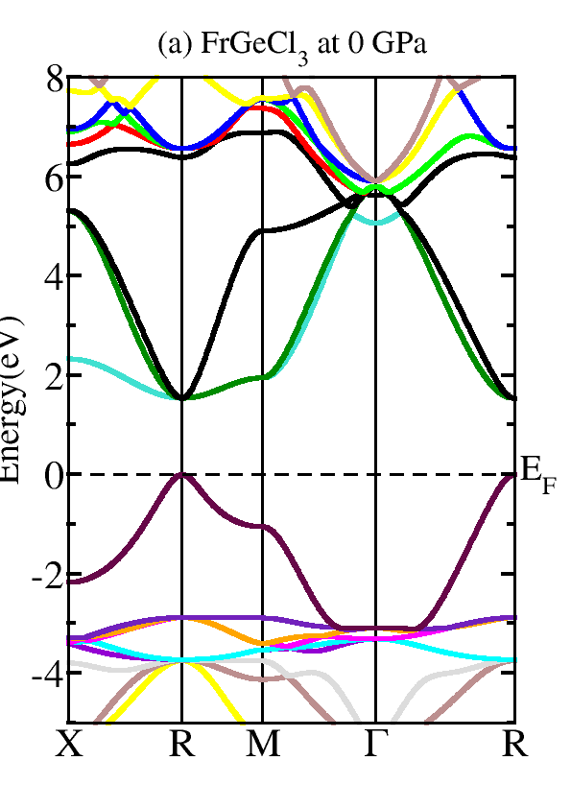
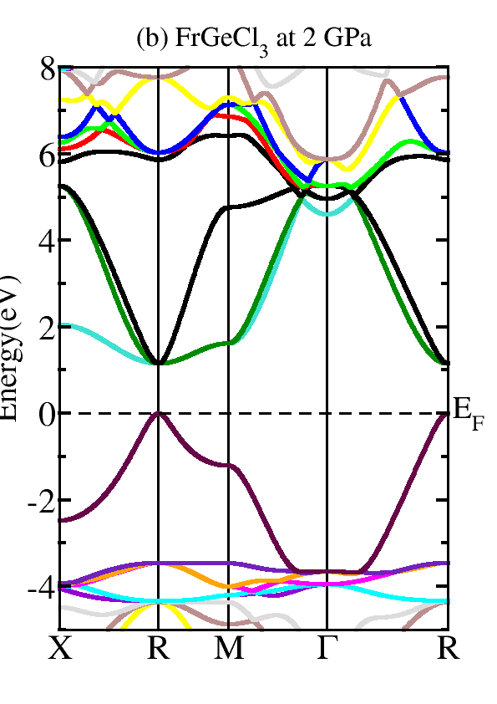
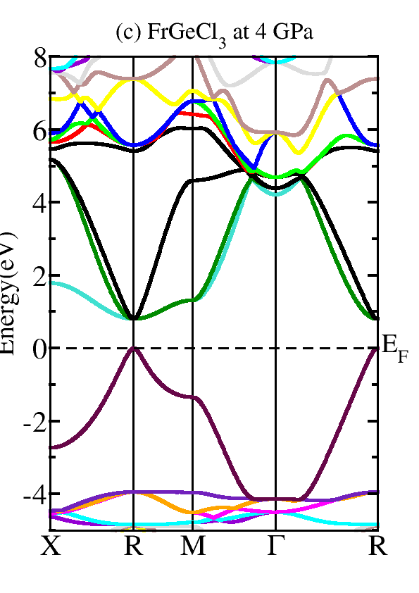
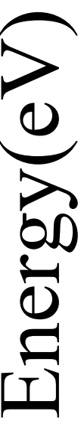
Electronic properties of FrGeCl₃

Slide 10
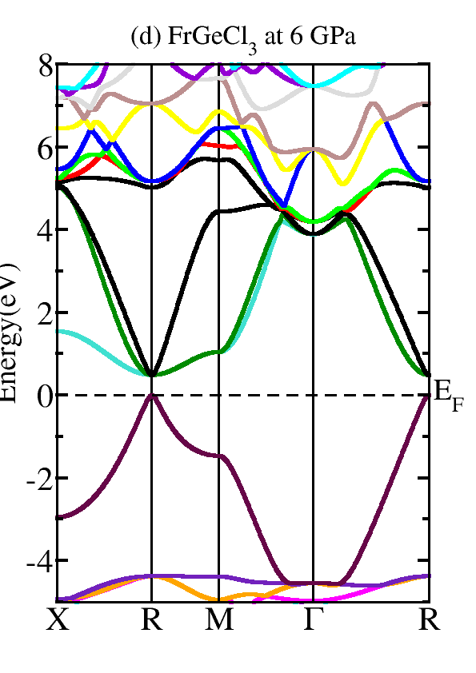
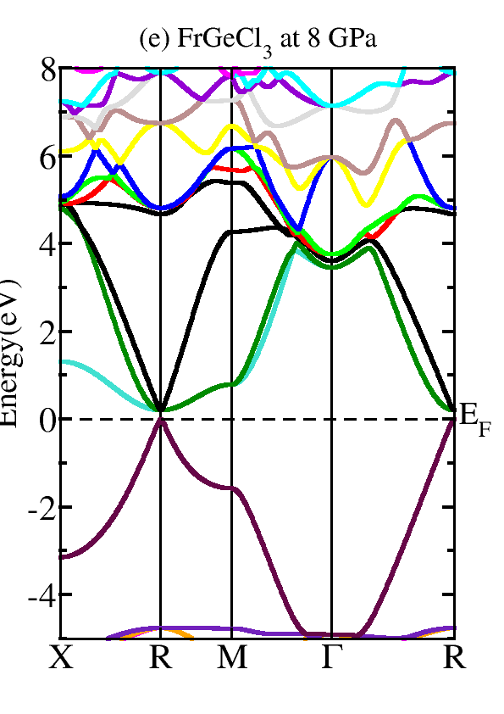
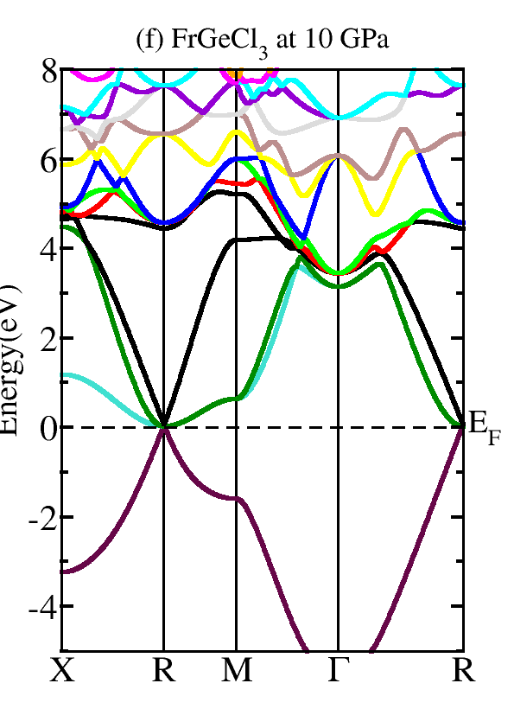
Electronic properties of FrGeCl₃

Slide 11
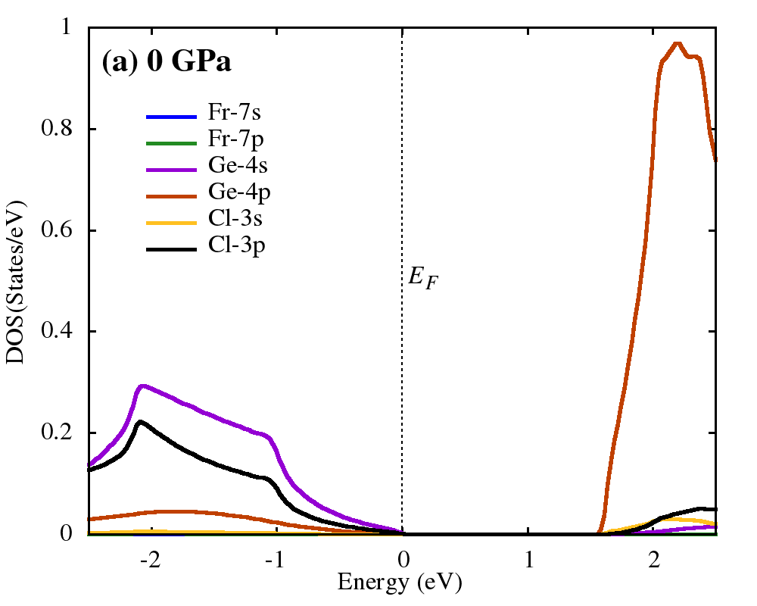
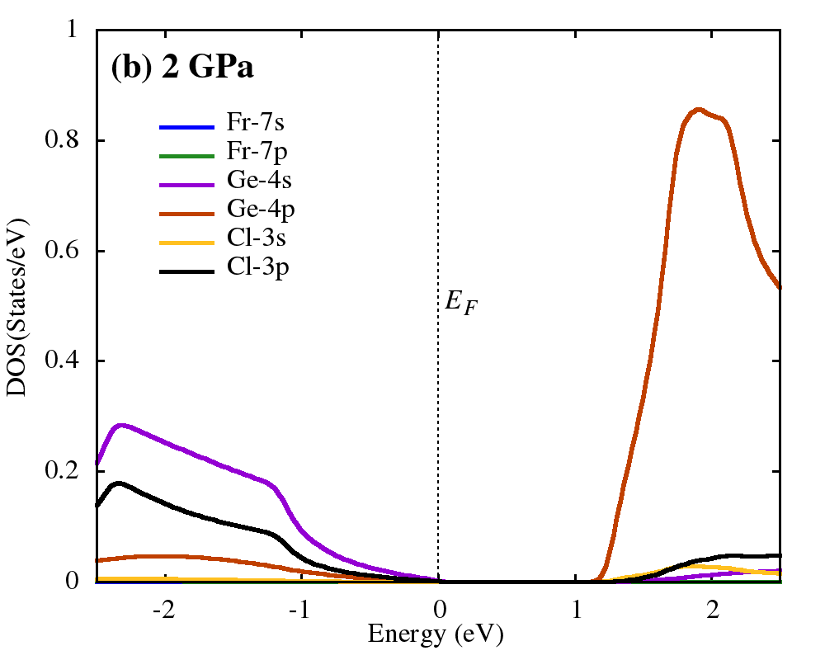
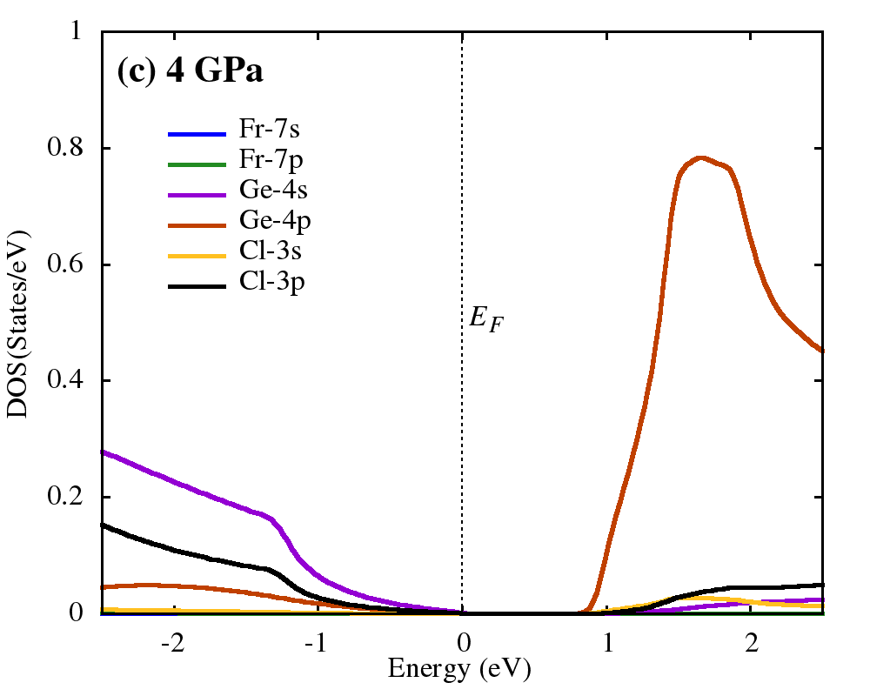
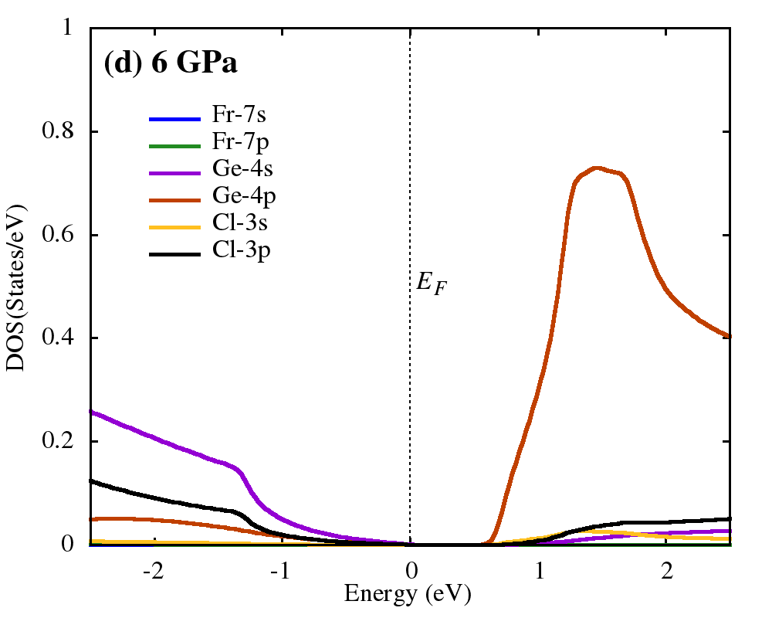
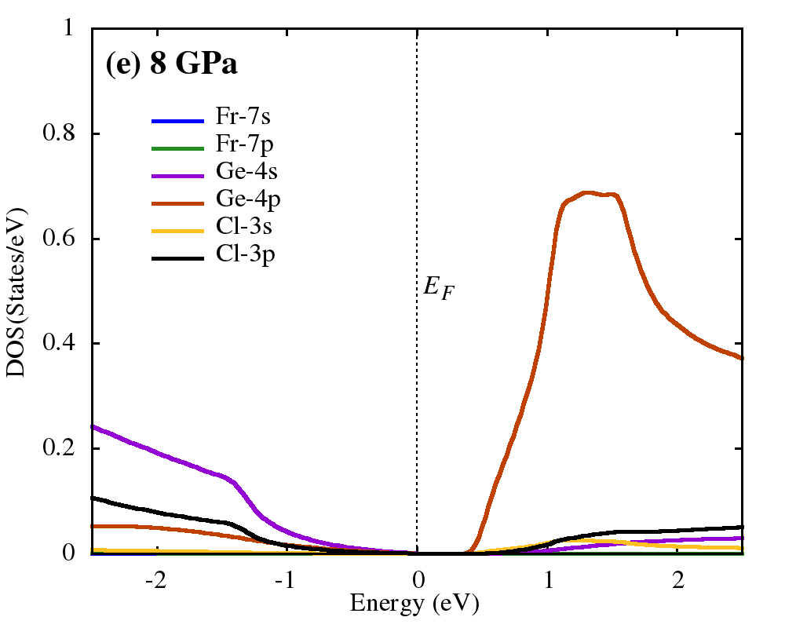
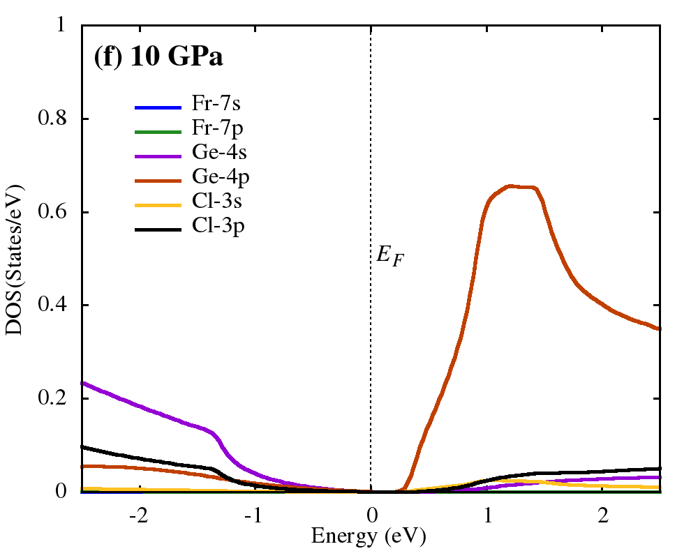
Electronic properties of FrGeCl₃

Slide 12
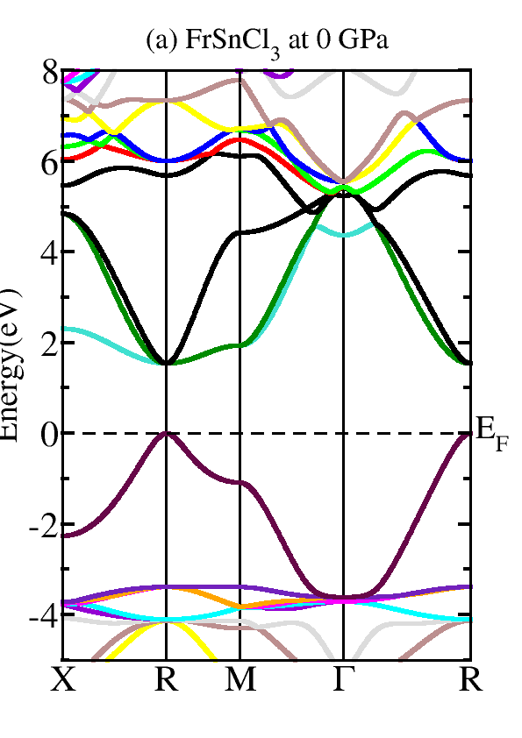
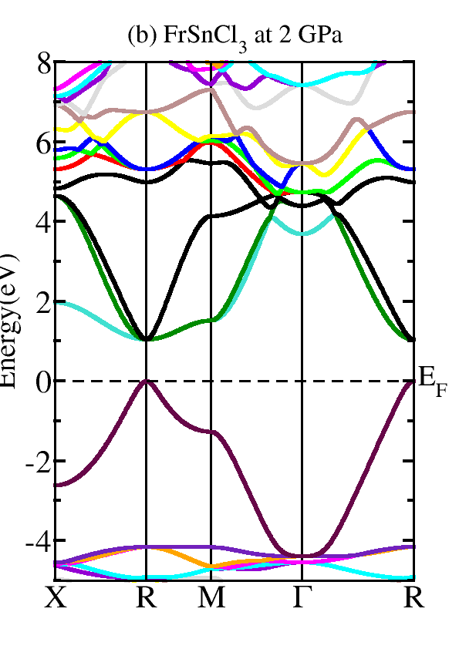
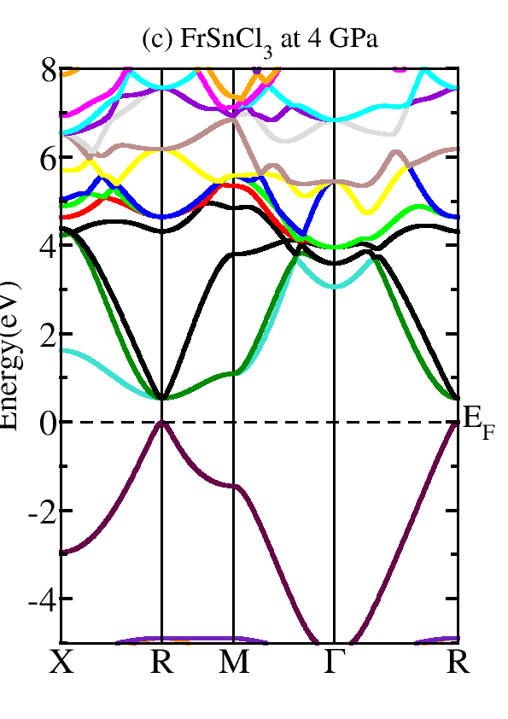
Electronic properties of FrSnCl₃

Slide 13
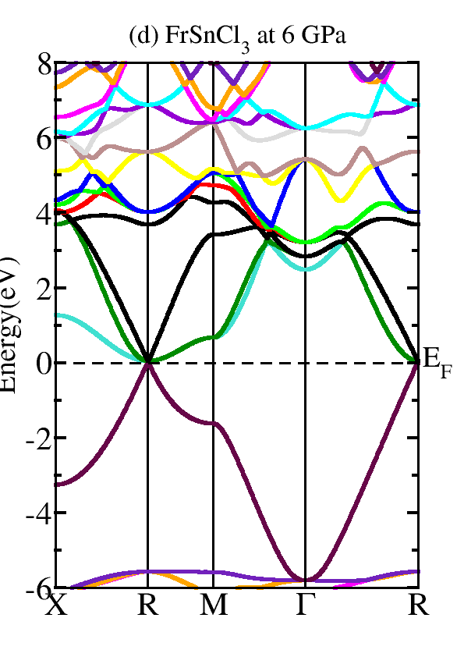
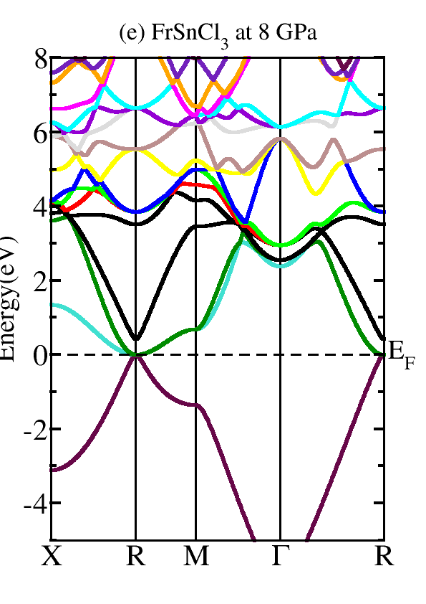
Electronic properties of FrSnCl₃

Slide 14
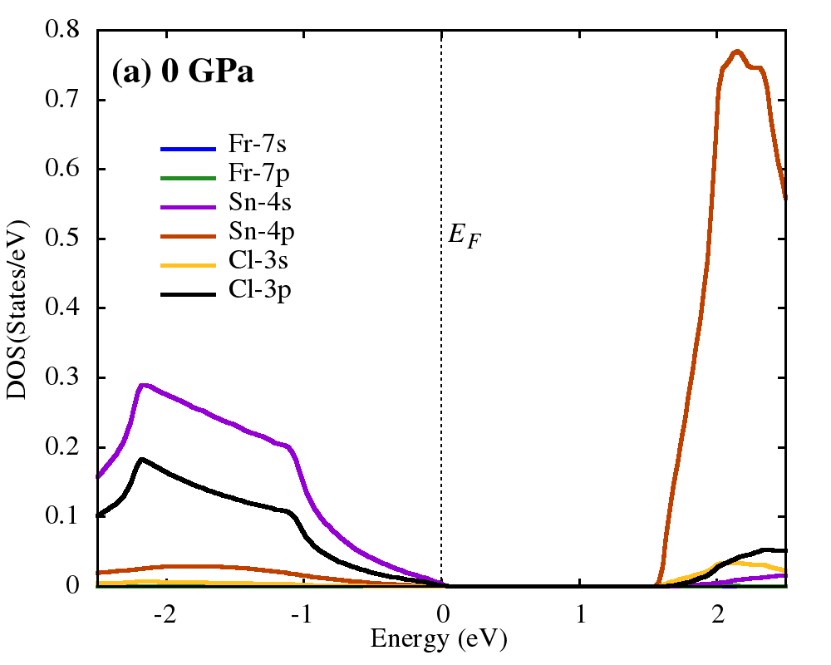
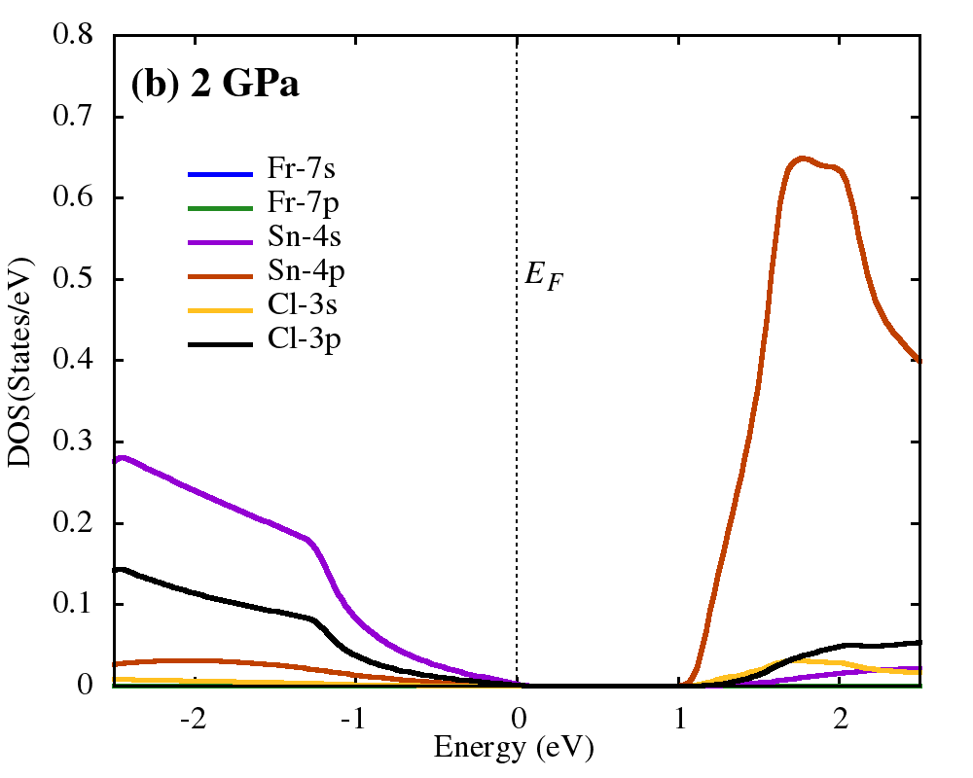
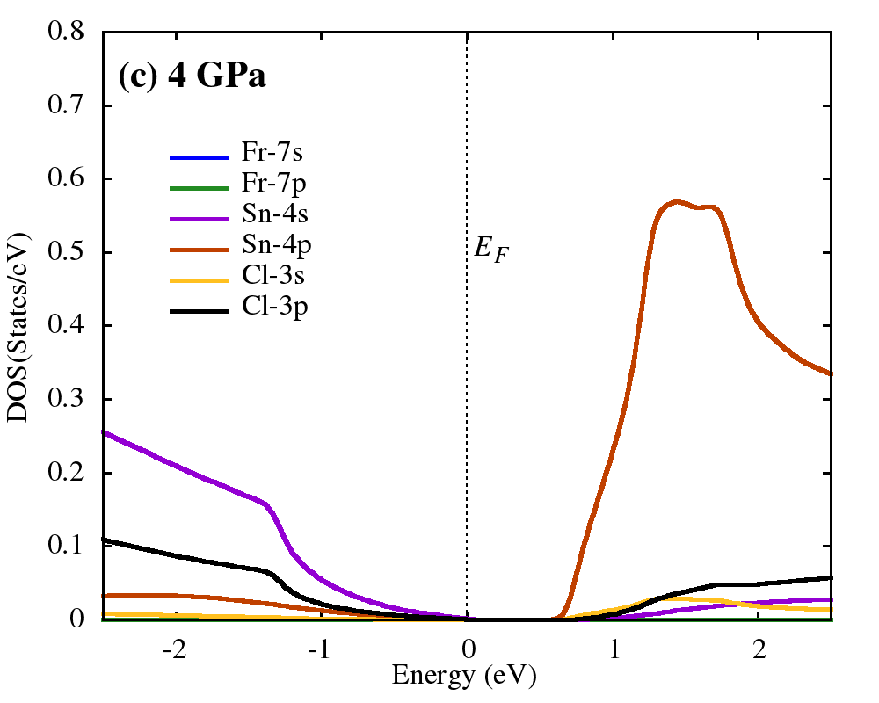
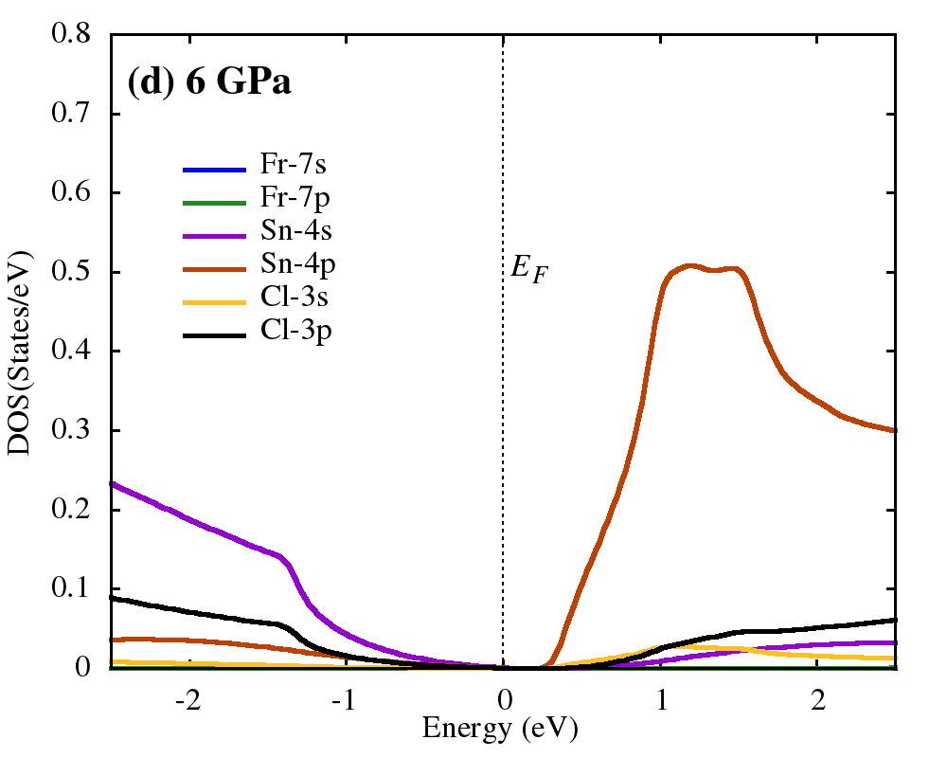
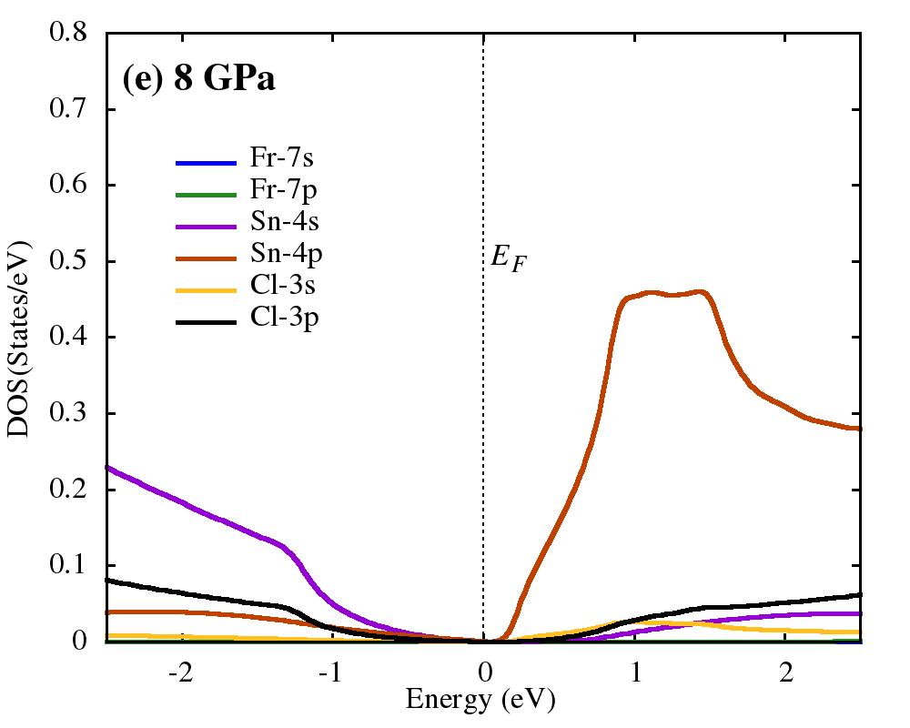
Electronic properties of FrSnCl₃

Slide 15
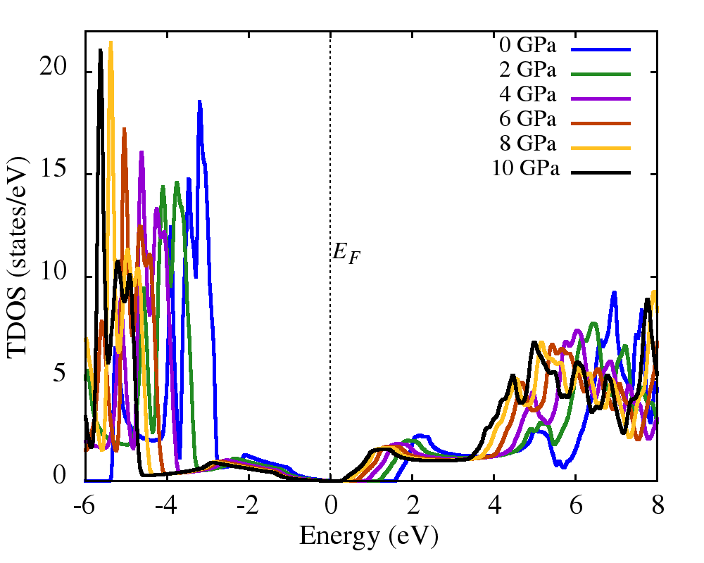
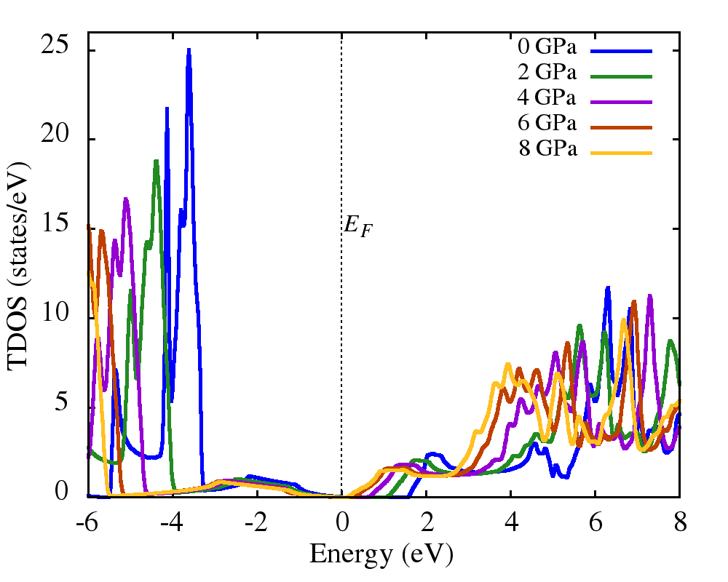
Electronic properties
FrGeCl₃
FrSnCl₃

Slide 16
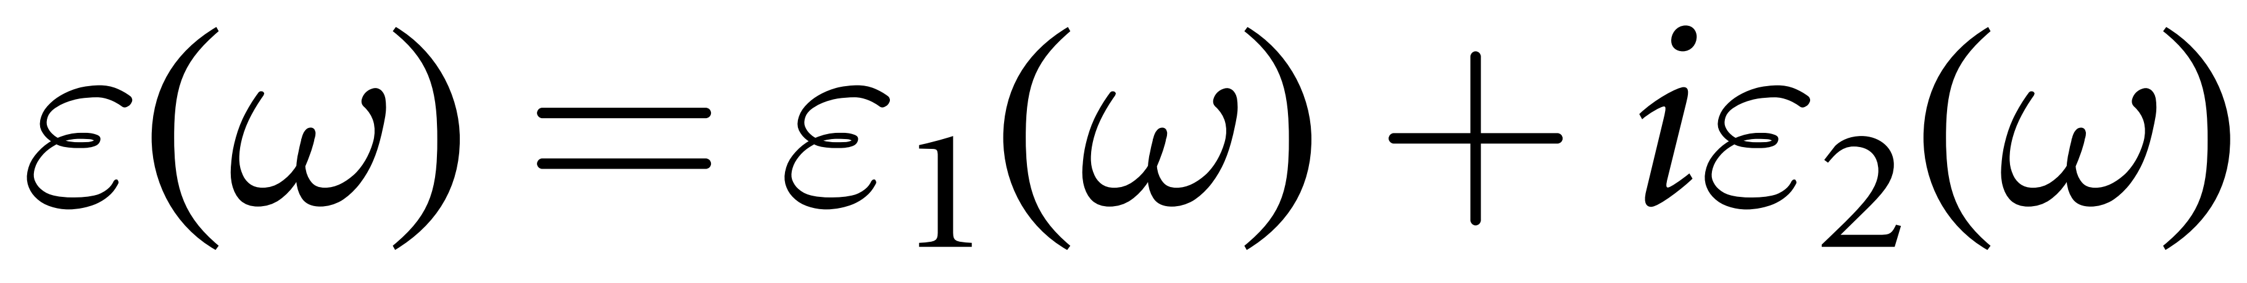
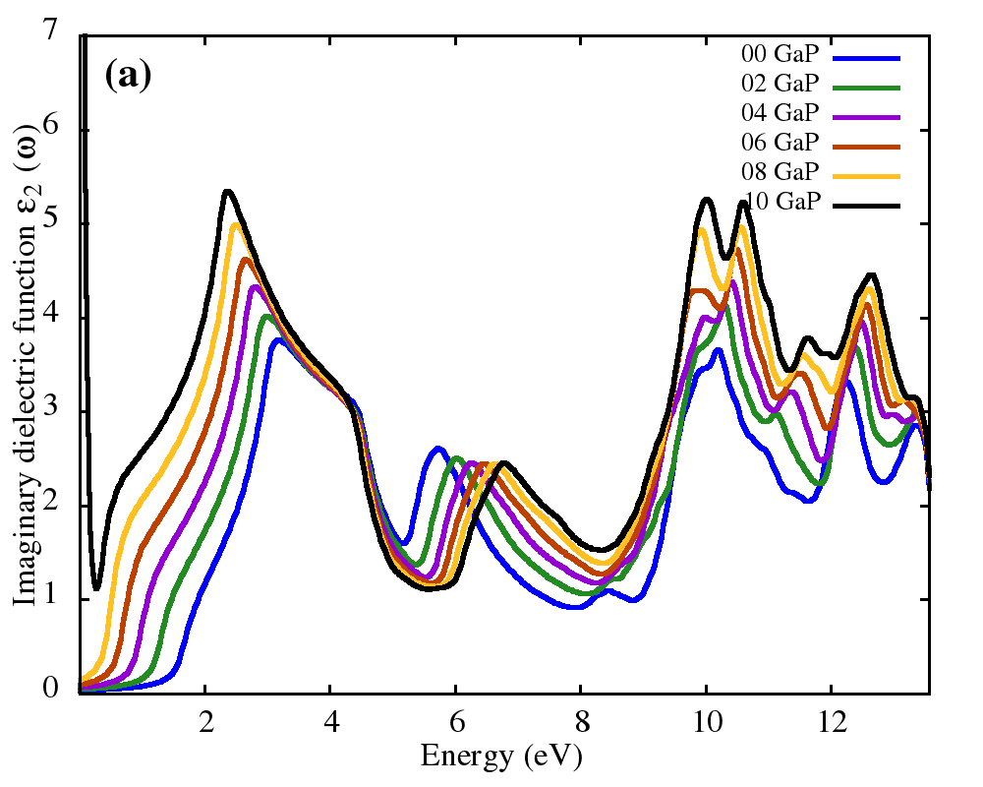
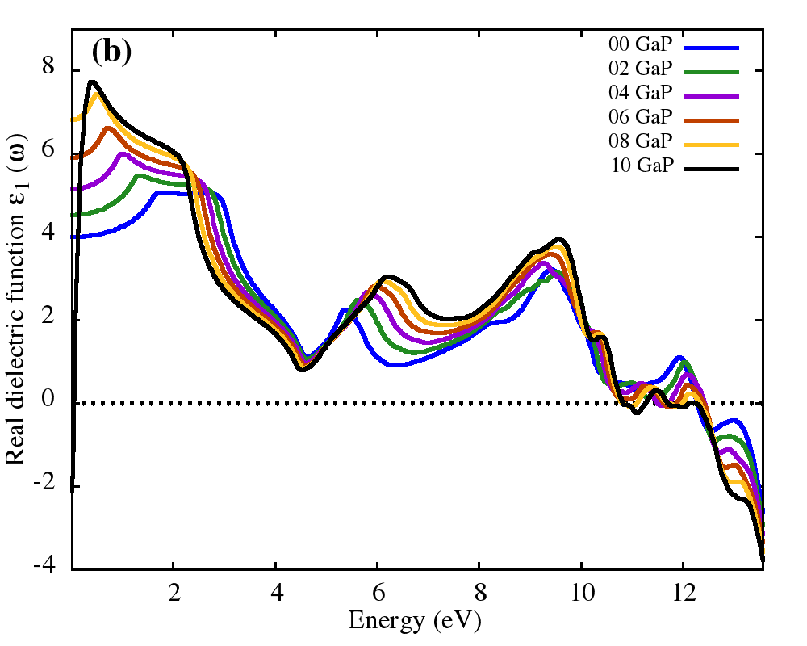
Optical properties of FrGeCl₃

Slide 17
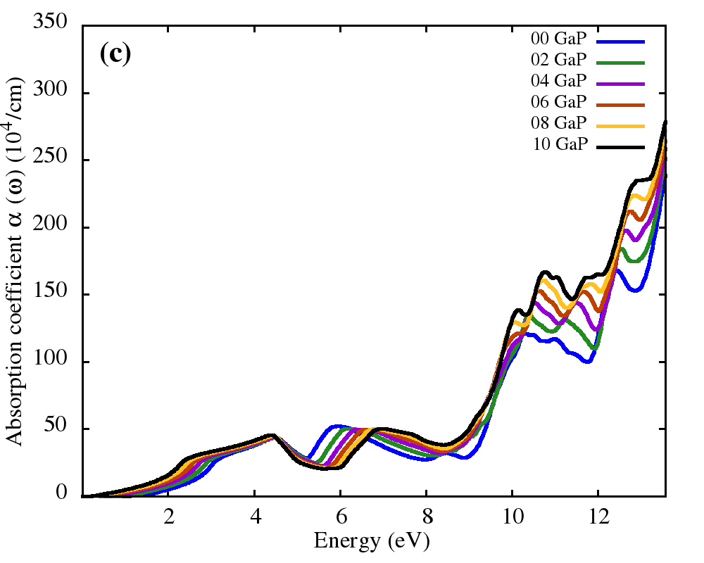
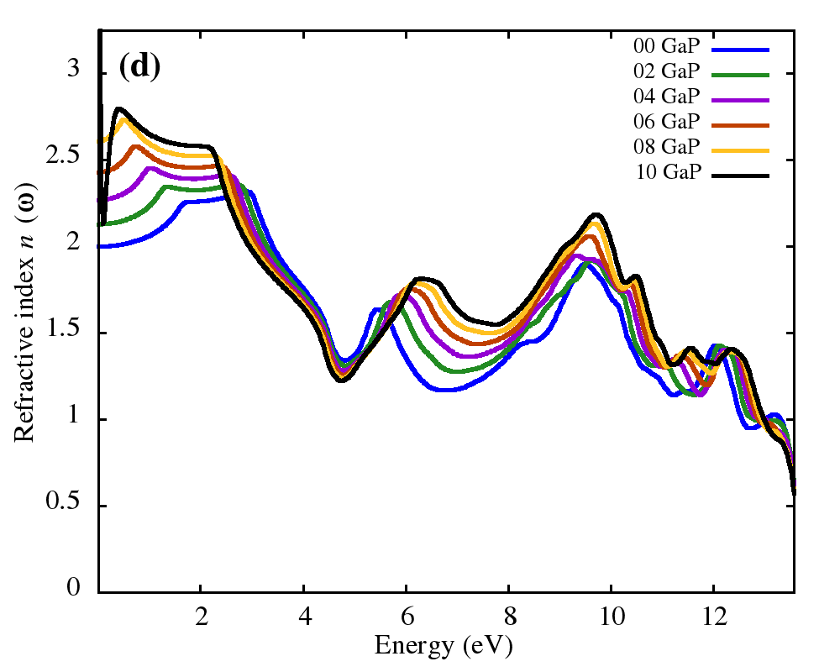
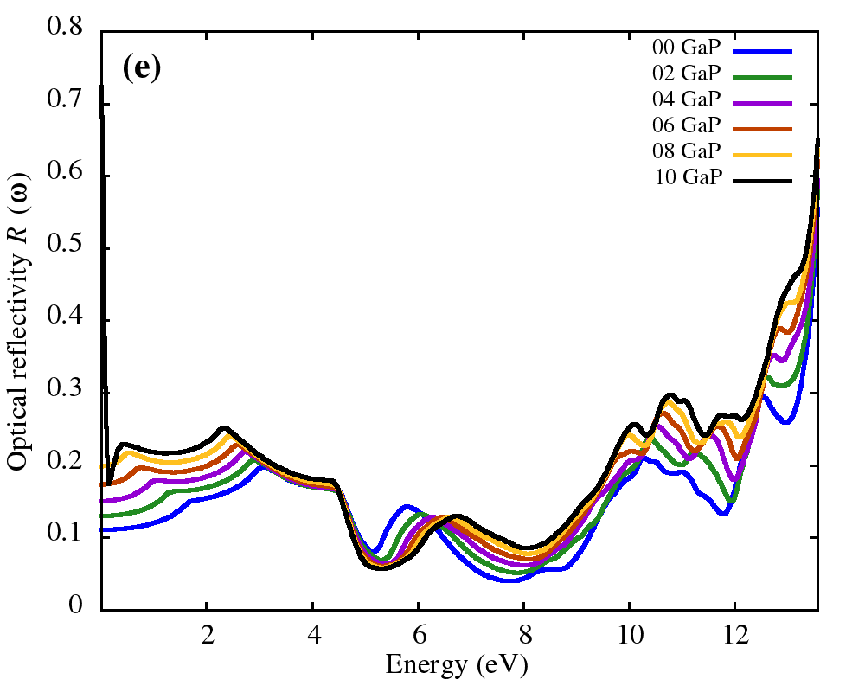
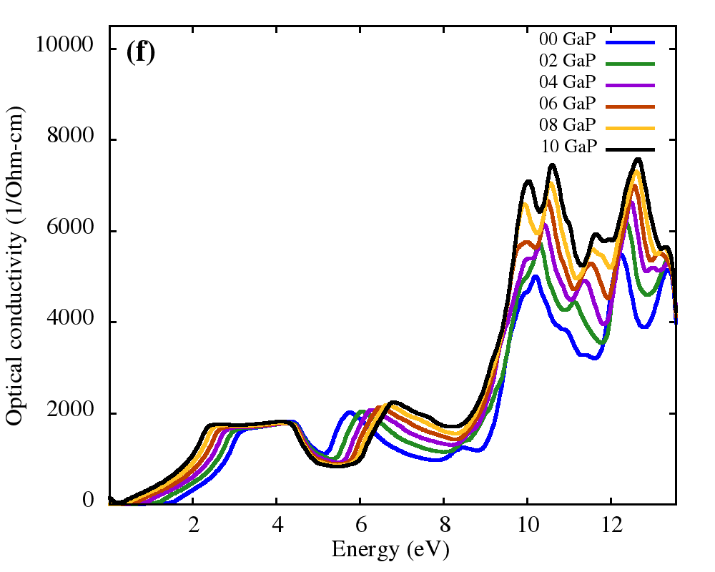
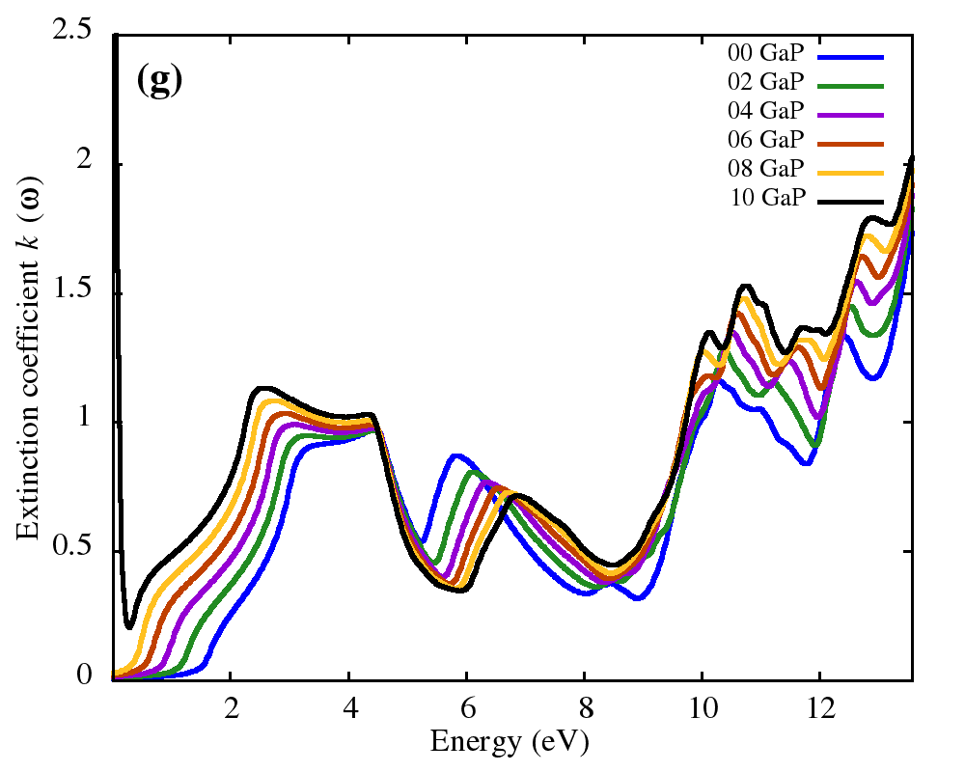
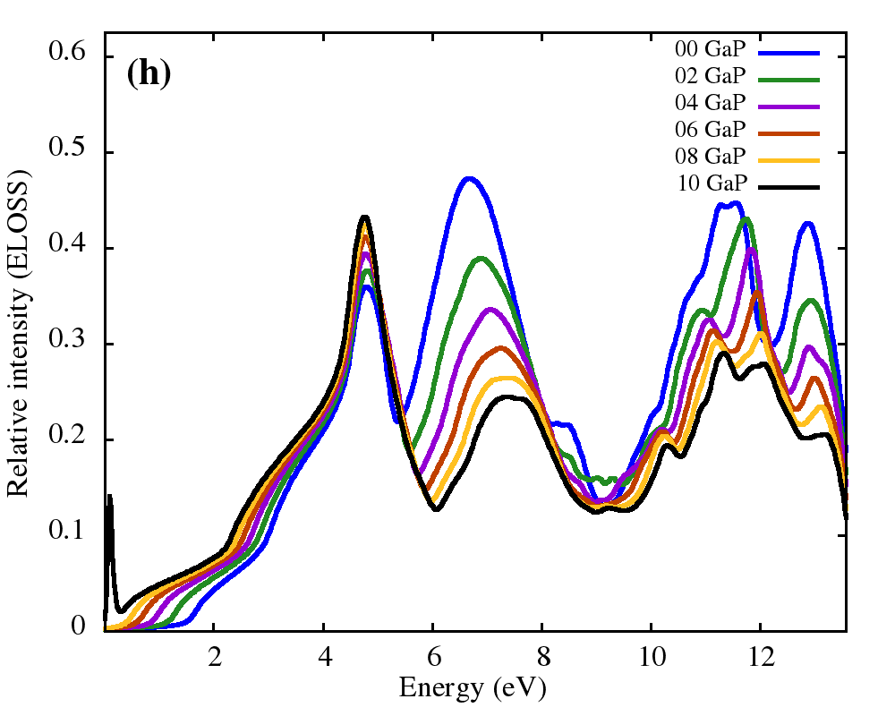
Optical properties of FrGeCl₃

Slide 18
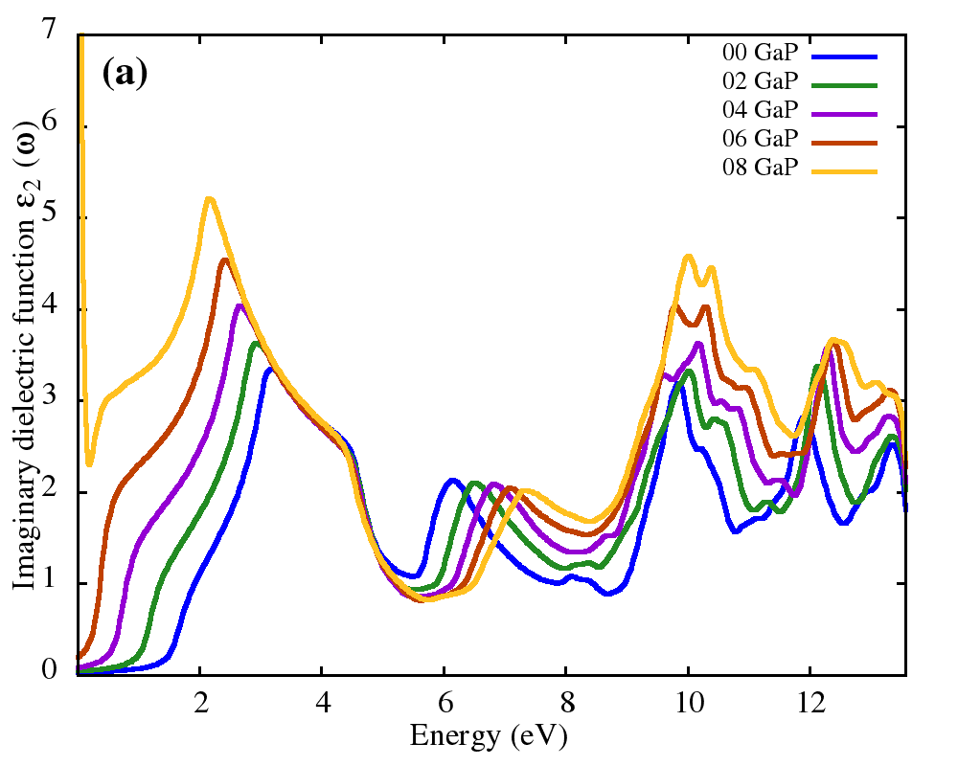
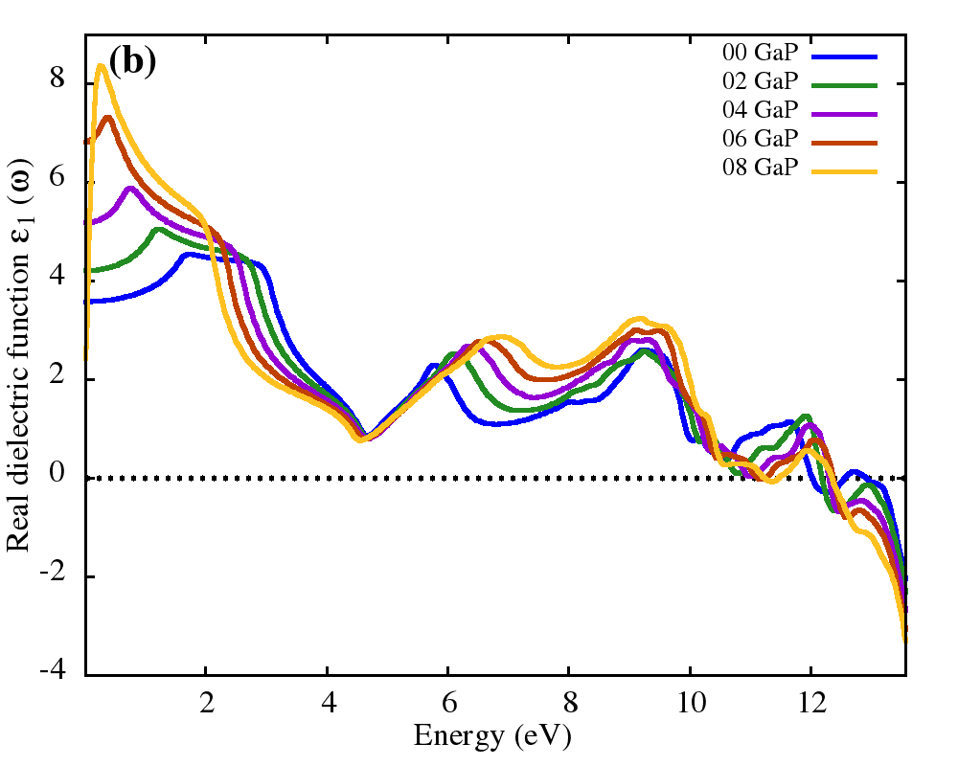
Optical properties of FrSnCl₃

Slide 19
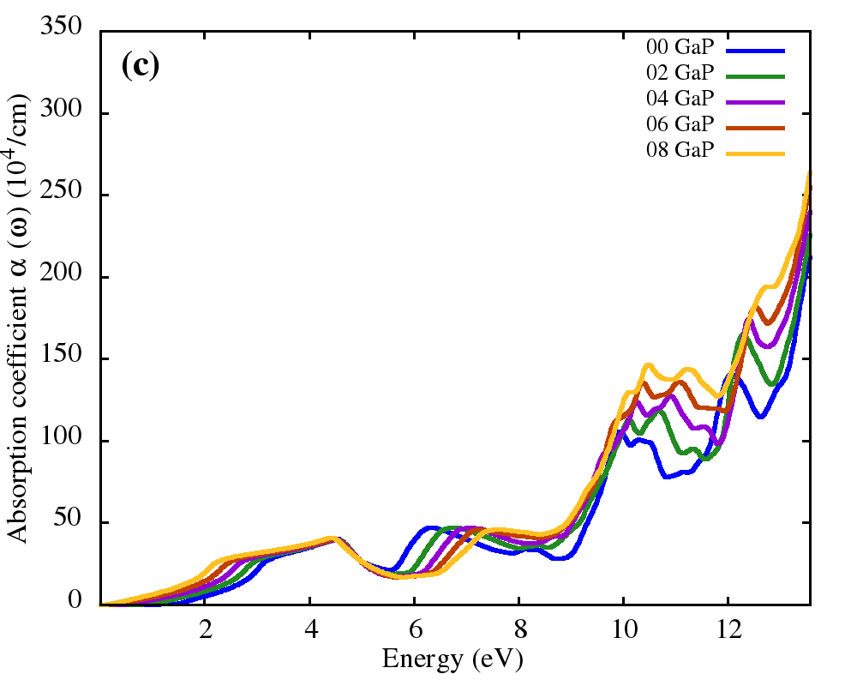
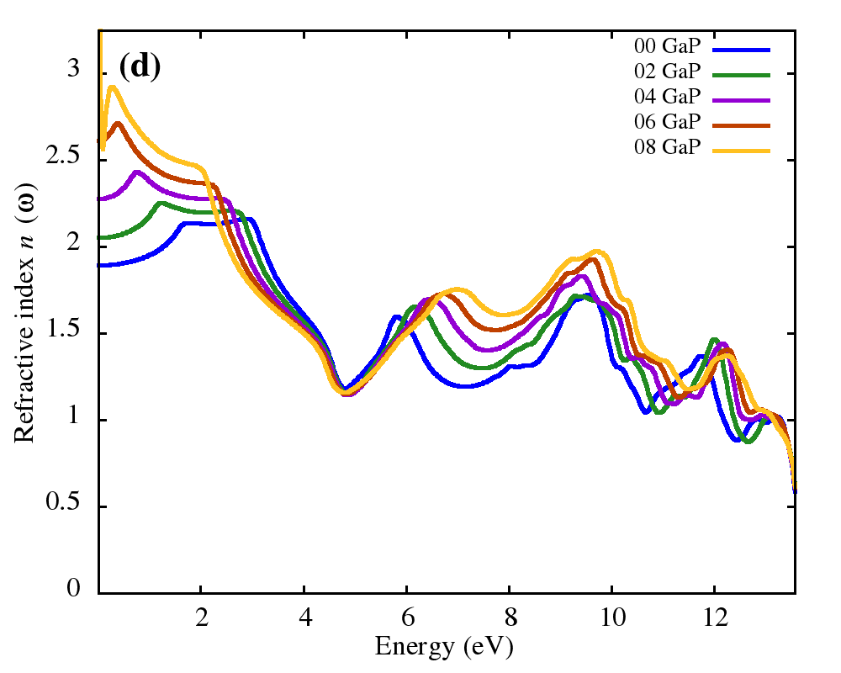
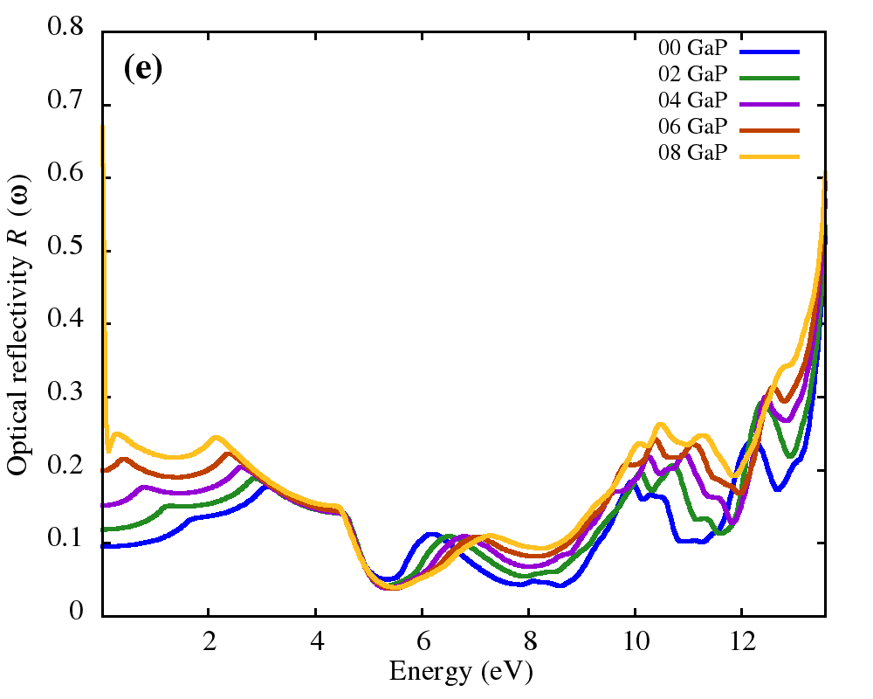
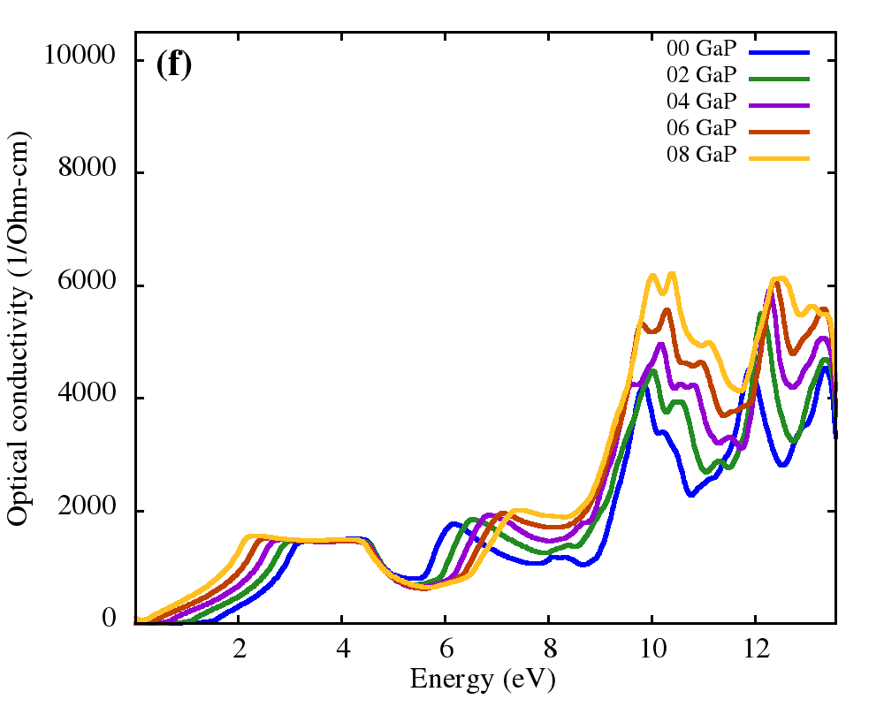
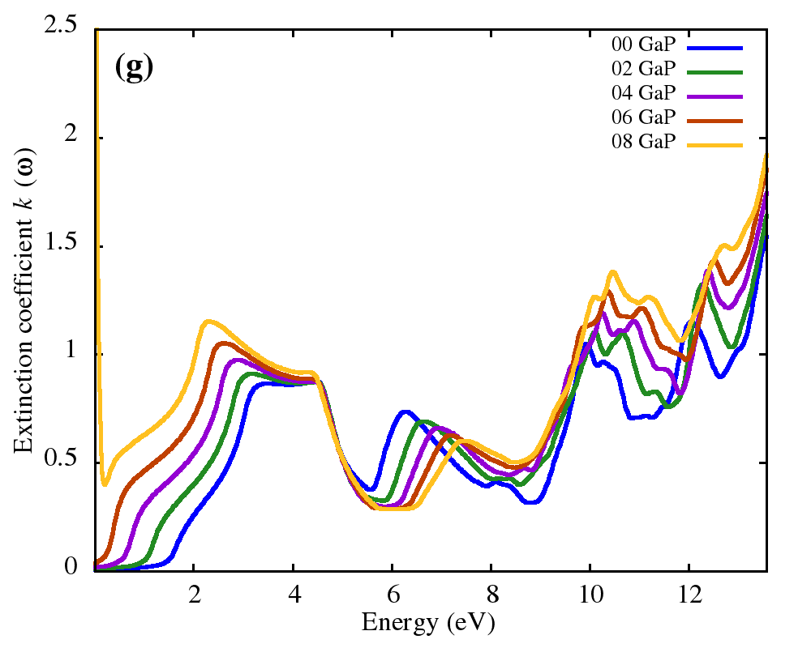
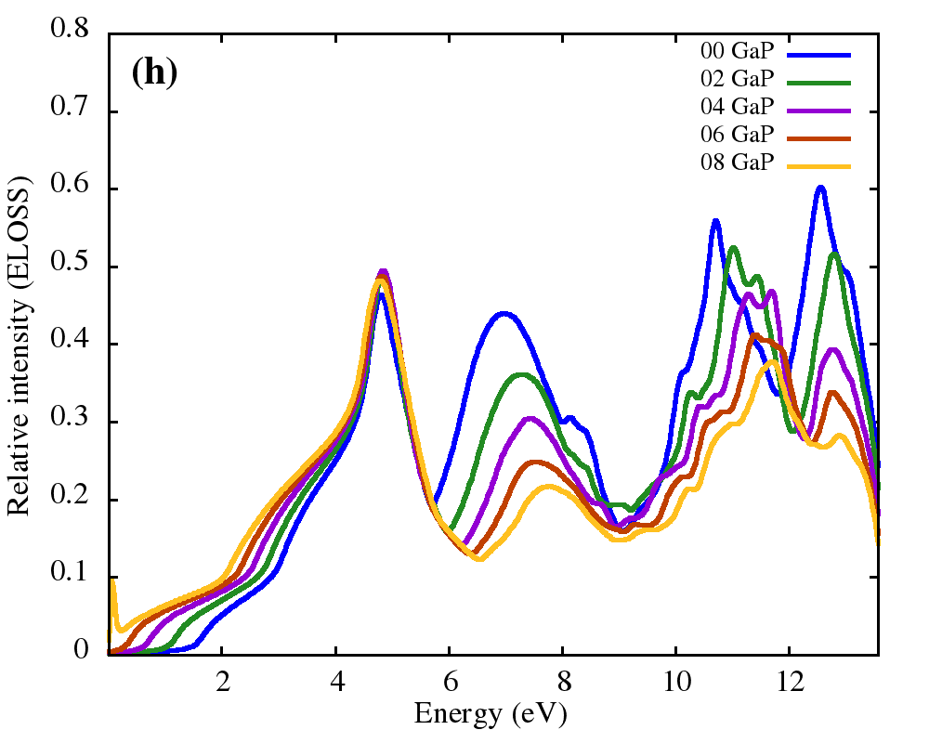
Optical properties of FrSnCl₃

Slide 20
Mechanical properties of FrBCl₃ (B = Ge, Sn)
System | Pressure (GPa) | C₁₁ | C₁₂ | C₄₄ | B (GPa) | G (GPa) | Y (GPa) | B/G | ν
FrGeCl₃ | 0 | 51.86 | 13.01 | 10.79 | 25.96 | 14.24 | 36.12 | 1.823 | 0.27
 | 2 | 68.73 | 17.08 | 12.07 | 34.30 | 17.57 | 45.03 | 1.952 | 0.28
 | 4 | 84.69 | 20.61 | 13.88 | 41.97 | 21.15 | 54.32 | 1.985 | 0.28
 | 6 | 102.41 | 22.86 | 15.69 | 49.38 | 25.32 | 64.88 | 1.950 | 0.28
 | 8 | 136.82 | 50.68 | 15.04 | 79.39 | 26.25 | 70.93 | 3.025 | 0.35
 | 10 | 125.02 | 29.01 | 15.34 | 61.01 | 28.41 | 73.77 | 2.148 | 0.30
FrSnCl₃ | 0 | 44.44 | 8.62 | 5.96 | 20.56 | 10.74 | 27.44 | 1.915 | 0.28
 | 2 | 73.35 | 12.14 | 10.11 | 32.54 | 18.31 | 46.25 | 1.777 | 0.26
 | 4 | 88.38 | 15.45 | 4.12 | 39.76 | 17.05 | 44.76 | 2.331 | 0.31
 | 6 | 108.25 | 18.22 | 4.81 | 48.23 | 20.89 | 54.76 | 2.309 | 0.31
 | 8 | 135.07 | 22.81 | 4.68 | 60.23 | 25.26 | 66.49 | 2.384 | 0.32

Slide 21




Thermoelectric properties of FrGeCl₃

Slide 22




Thermoelectric properties of FrSnCl₃

Slide 23
Conclusions
Opto-electronic and thermoelectric properties perovskites of FrBCl₃ (B = Ge, Sn) using WIEN2k
Both compounds show semiconductor like behavior
Remarkable optical properties and ductile in nature
Good Seebeck coefficient and power factor
Promising materials for different opto-electronic and thermoelectric applications

Slide 24


